Slide 1
VDJbase architecture
https://vdjbase.org
Backend Python 3.9
Flask Flask-RESTX
Client Angular 11 single-page app
Asynchronous tasks (for report running)
REST API
Celery
https://vdjbase.org/admin/api
https://github.com/williamdlees/digby_backend
https://github.com/williamdlees/digby
Dataset 1 (e.g. Human/IGH)
- db.sqlite3
- Sample files on disk
Dataset n (e.g. Human/IGH)
- db.sqlite3
- Sample files on disk
Datasets are created in Github before deployment to the server
e.g. https://github.com/williamdlees/digby_data/tree/master/AIRR-seq/Human/IGH/db.sqlite https://github.com/williamdlees/digby_data/tree/master/AIRR-seq/Human/IGH/samples

Slide 2
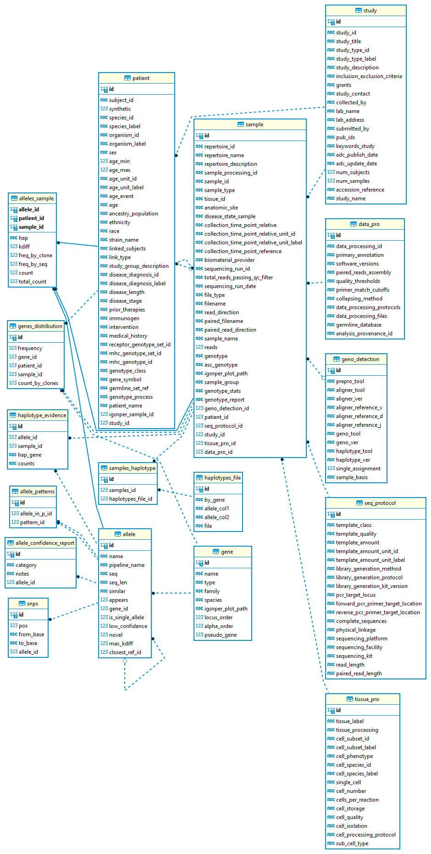
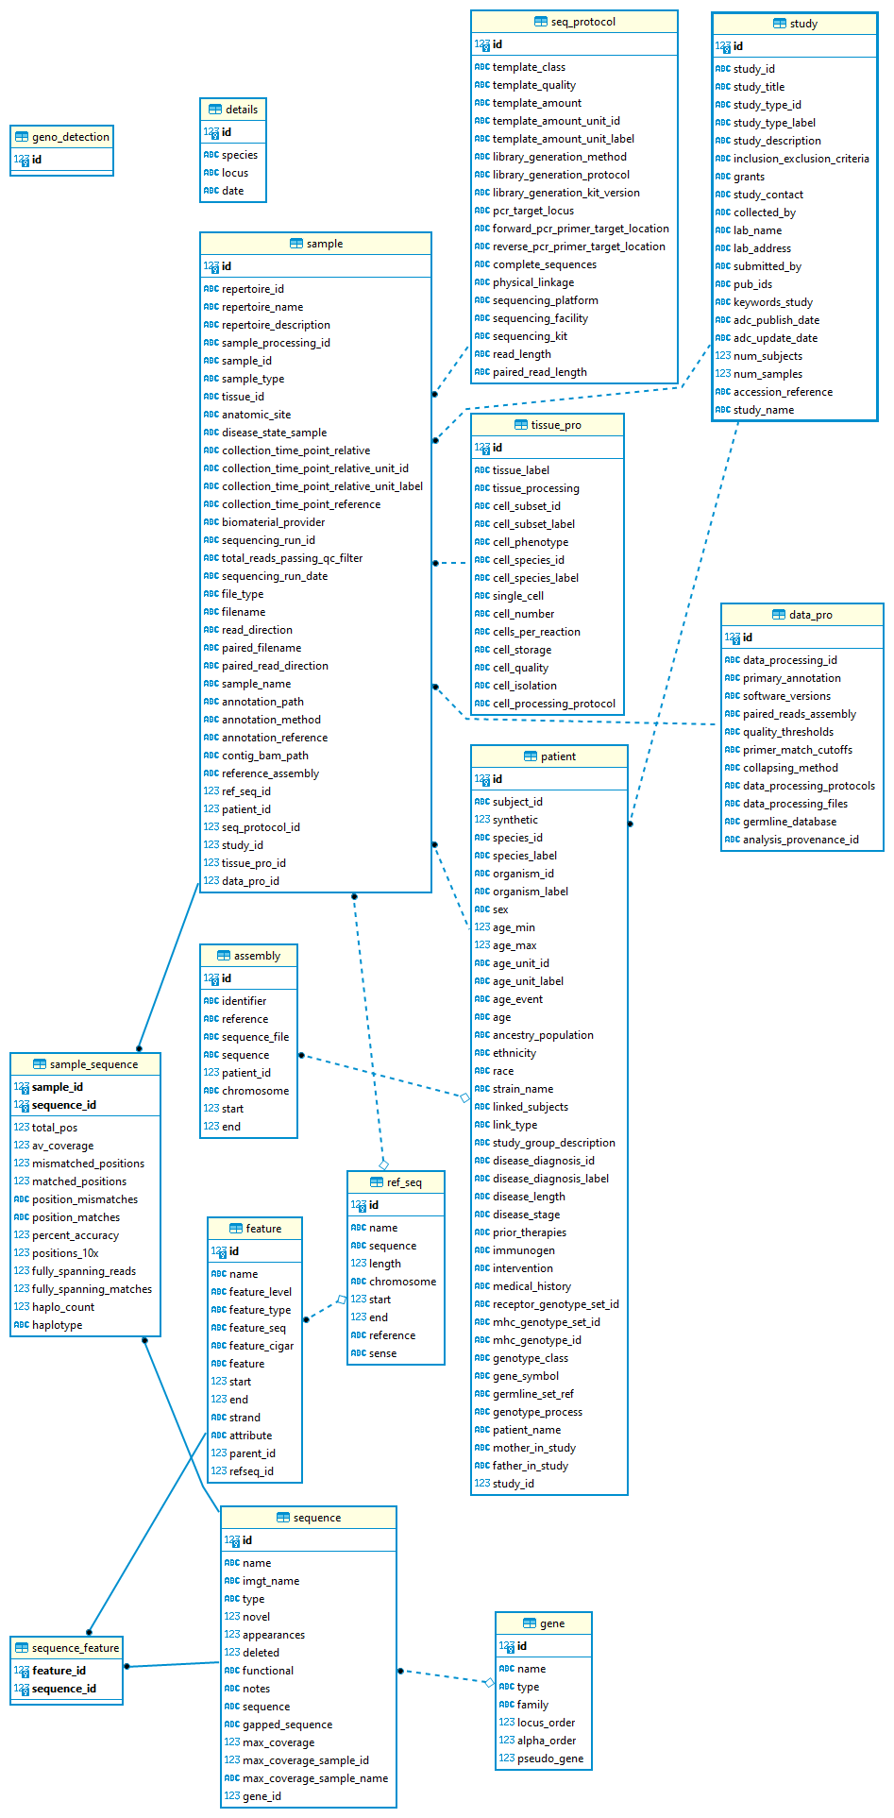
VDJbase schemas
https://github.com/williamdlees/digby_backend/blob/master/vdjbase_schema.png (airr-seq)
https://github.com/williamdlees/digby_backend/blob/master/genomic_schema.png

